Slide 1
Microsoft Fabric How to keep your items and data safe
Using Microsoft Fabric
Tom Martens @ Global Power Platform Bootcamp (Hamburg)
2024-02-24

Slide 2
Inside the box
Who I am
Power BI Recap (a look behind)
Microsoft Fabric is entering the stage

Slide 3
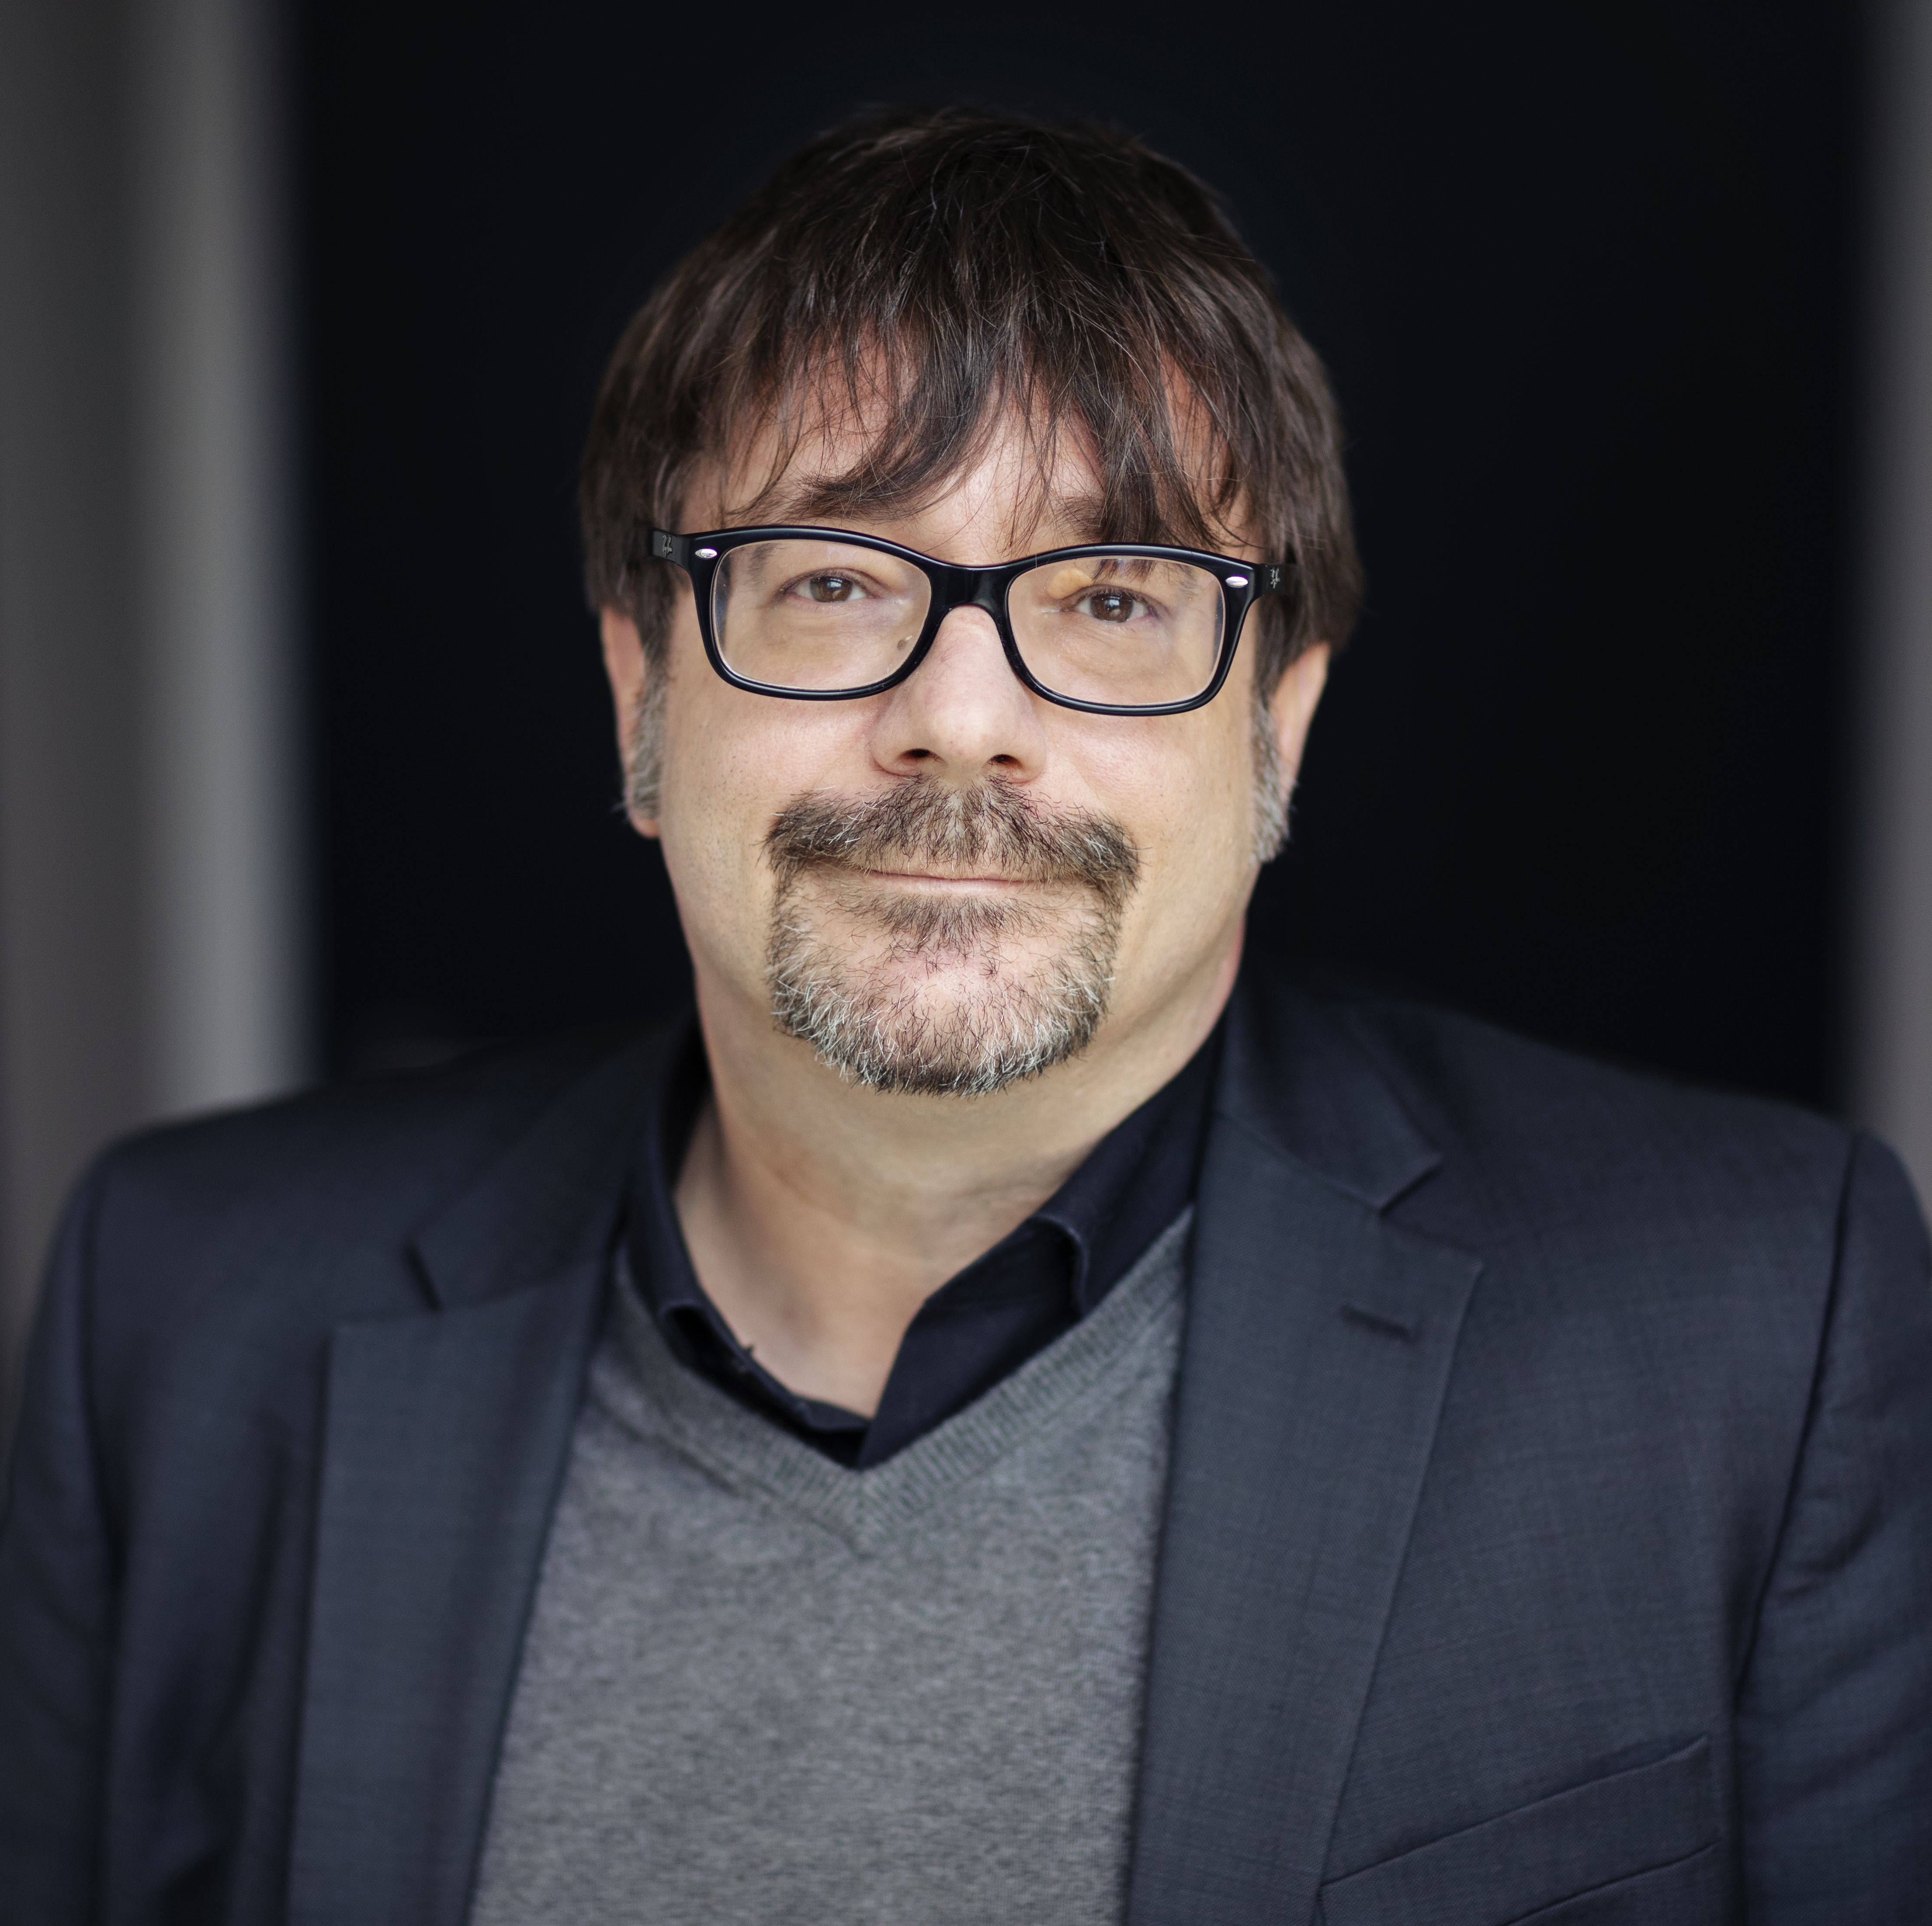
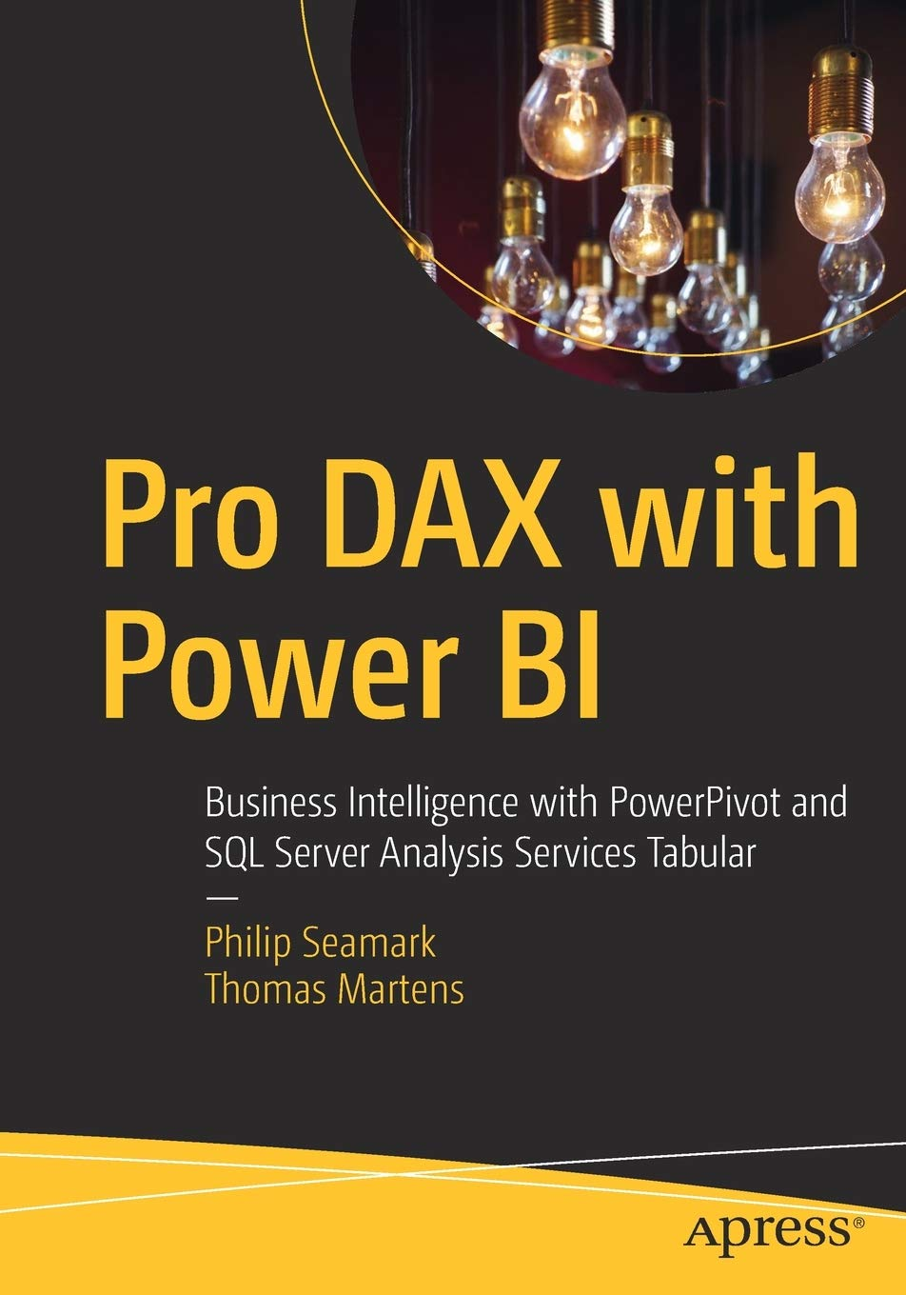
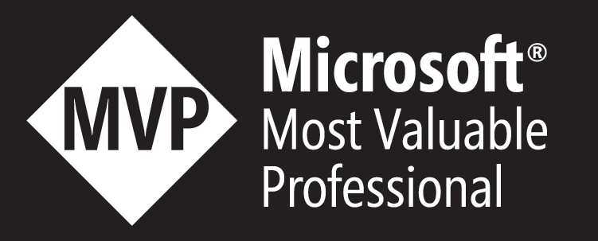
Tom Martens
25+ years of experience designing analytical solutions using the MSFT data platform
Solution Architect @ Munich Re
/tommartens68
@tommartens68

Slide 4

Power BI Recap (a look behind)

Slide 5
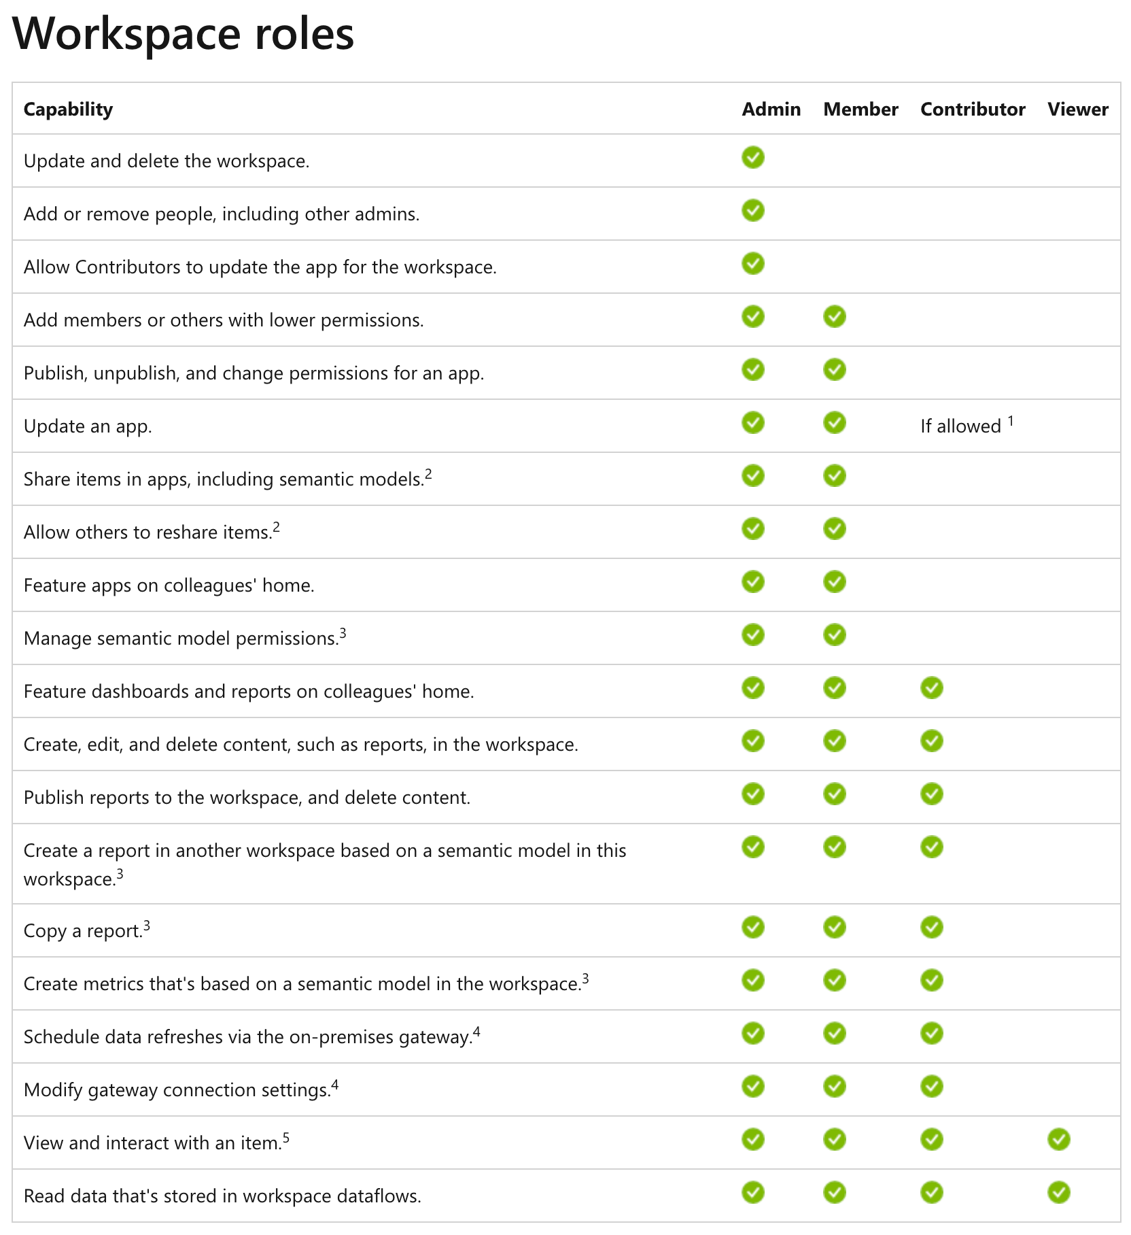









How we work today – our beloved workspace

Slide 6
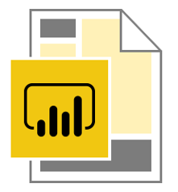







How we work today – thin reports
Separating the data (the semantic model) from the content (our data visualizations)
Data workspace
Content workspace(s)
Create 1 to n content workspaces
This allows us to reuse the existing semantic models. This is not the same as multiple audiences per app 😉
Content creators only require the contributor role assigned in the content workspace
Content creators are connecting to the Power BI semantic model
Content creators are not members of the data workspace
Content creators need Build Permission on the semantic model
Row Level Security will be honored if data and content workspaces are separated
Create a data workspace and consider a workspace being an Analysis Services Tabular instance!
Using multiple Power BI files, connected to a Power BI dataset instead of the data sources: thin reports

Slide 7
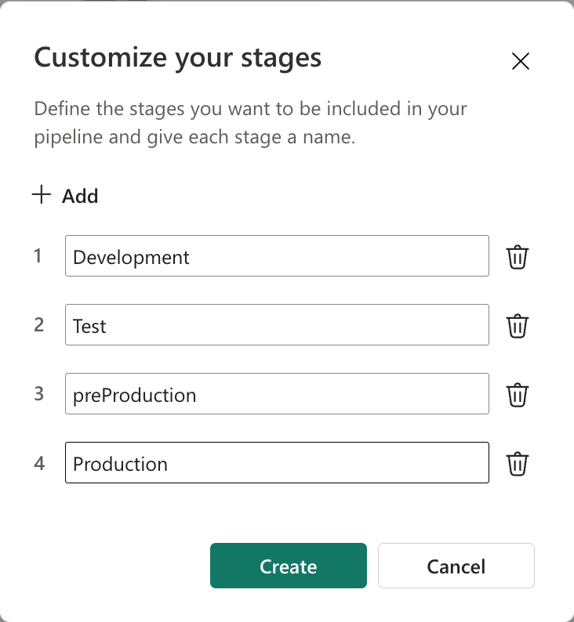

How we work today – deployment (before Fabric, not considering synching between a Fabric workspace and Azure DevOps repo)
PROD stage
Configure your Power BI Deployment pipeline (from 2 to 10 deployment stages)
prePROD stage
Use the
Power BI deployment features to push items to the stages additional
Use Azure deployment pipelines leveraging the Power BI deployment APIs if you need more control (items are not stored in AzDevOps)
TEST stage
DEV stage
Publish pbix to DEV workspace(s)
We use 8 workspaces for a Power BI solution, hopefully there is more to it than a meaningless pie chart

Slide 8

Microsoft Fabric is entering the stage

Slide 9
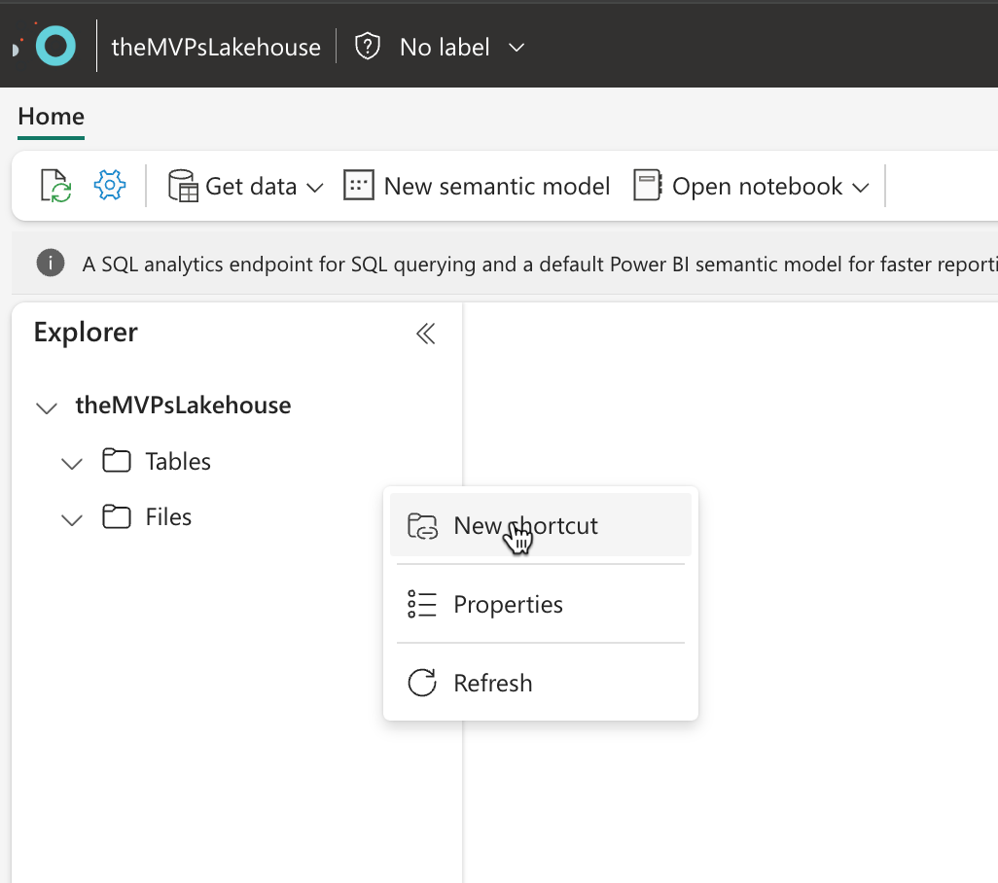
Start creating a shortcut

Slide 10
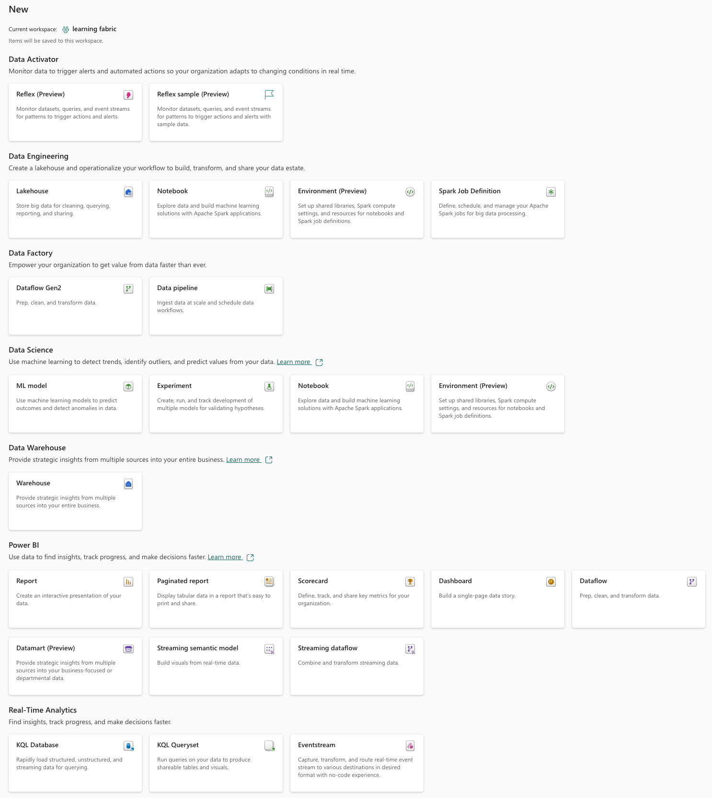
Our Power BI “world” has transformed into a Microsoft Fabric cosmos (basically, this is good)
The amazing things we can create now!

Slide 11

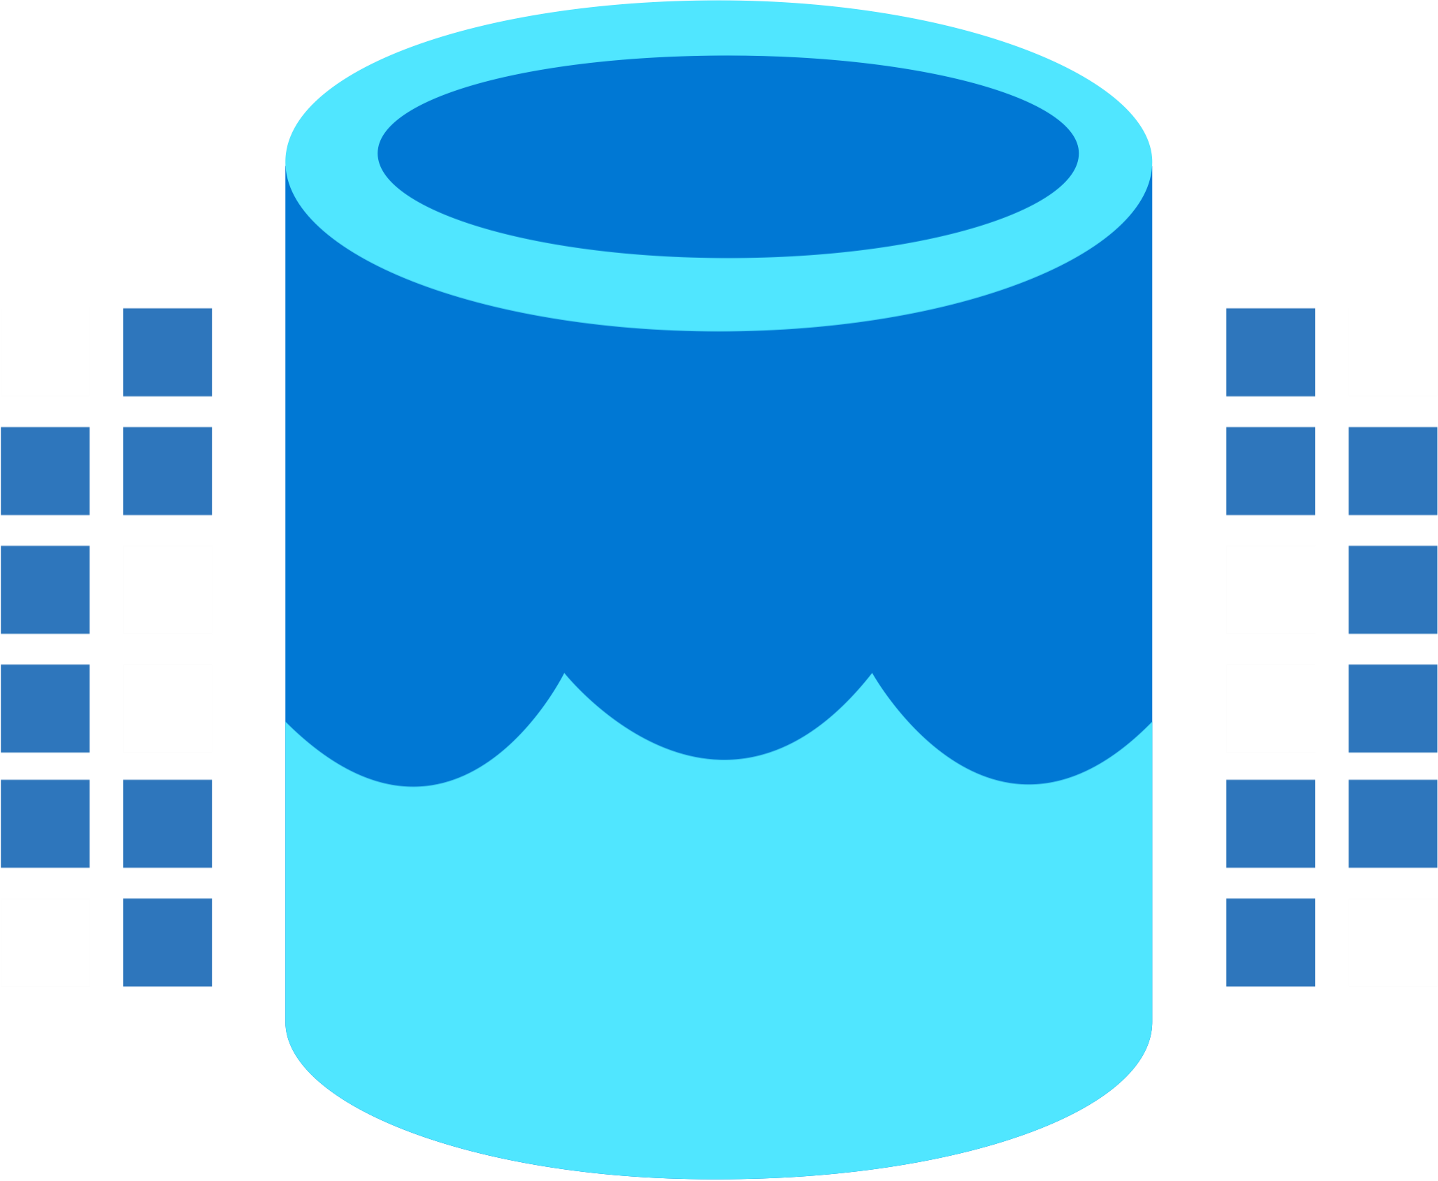


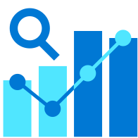

It’s not just the items we are able to create, the team is growing
Data Integration
Data Lake
Spark Engines
Data
Warehouse
Real Time Analytics
Data
Science
Business
Intelligence
Governance
Microsoft Fabric Unified analytics platform
End-to-end analytics data fabric
From the data lake to the business user

Slide 12
It’s not just the items we are able to create, the team is growing
Data Integration
Data Lake
Spark Engines
Data
Warehouse
Real Time Analytics
Data
Science
Business
Intelligence
Governance
Microsoft Fabric Unified analytics platform
End-to-end analytics data fabric
From the data lake to the business user

Slide 13
It’s not just the items we are able to create, the team is growing
Data Integration
Data Lake
Spark Engines
Data
Warehouse
Real Time Analytics
Data
Science
Business
Intelligence
Governance
Microsoft Fabric Unified analytics platform
End-to-end analytics data fabric
From the data lake to the business user

Slide 14
The “simple” Power BI workspace roles (remember from some slides ago)
https://learn.microsoft.com/en-us/power-bi/collaborate-share/service-roles-new-workspaces

Slide 15


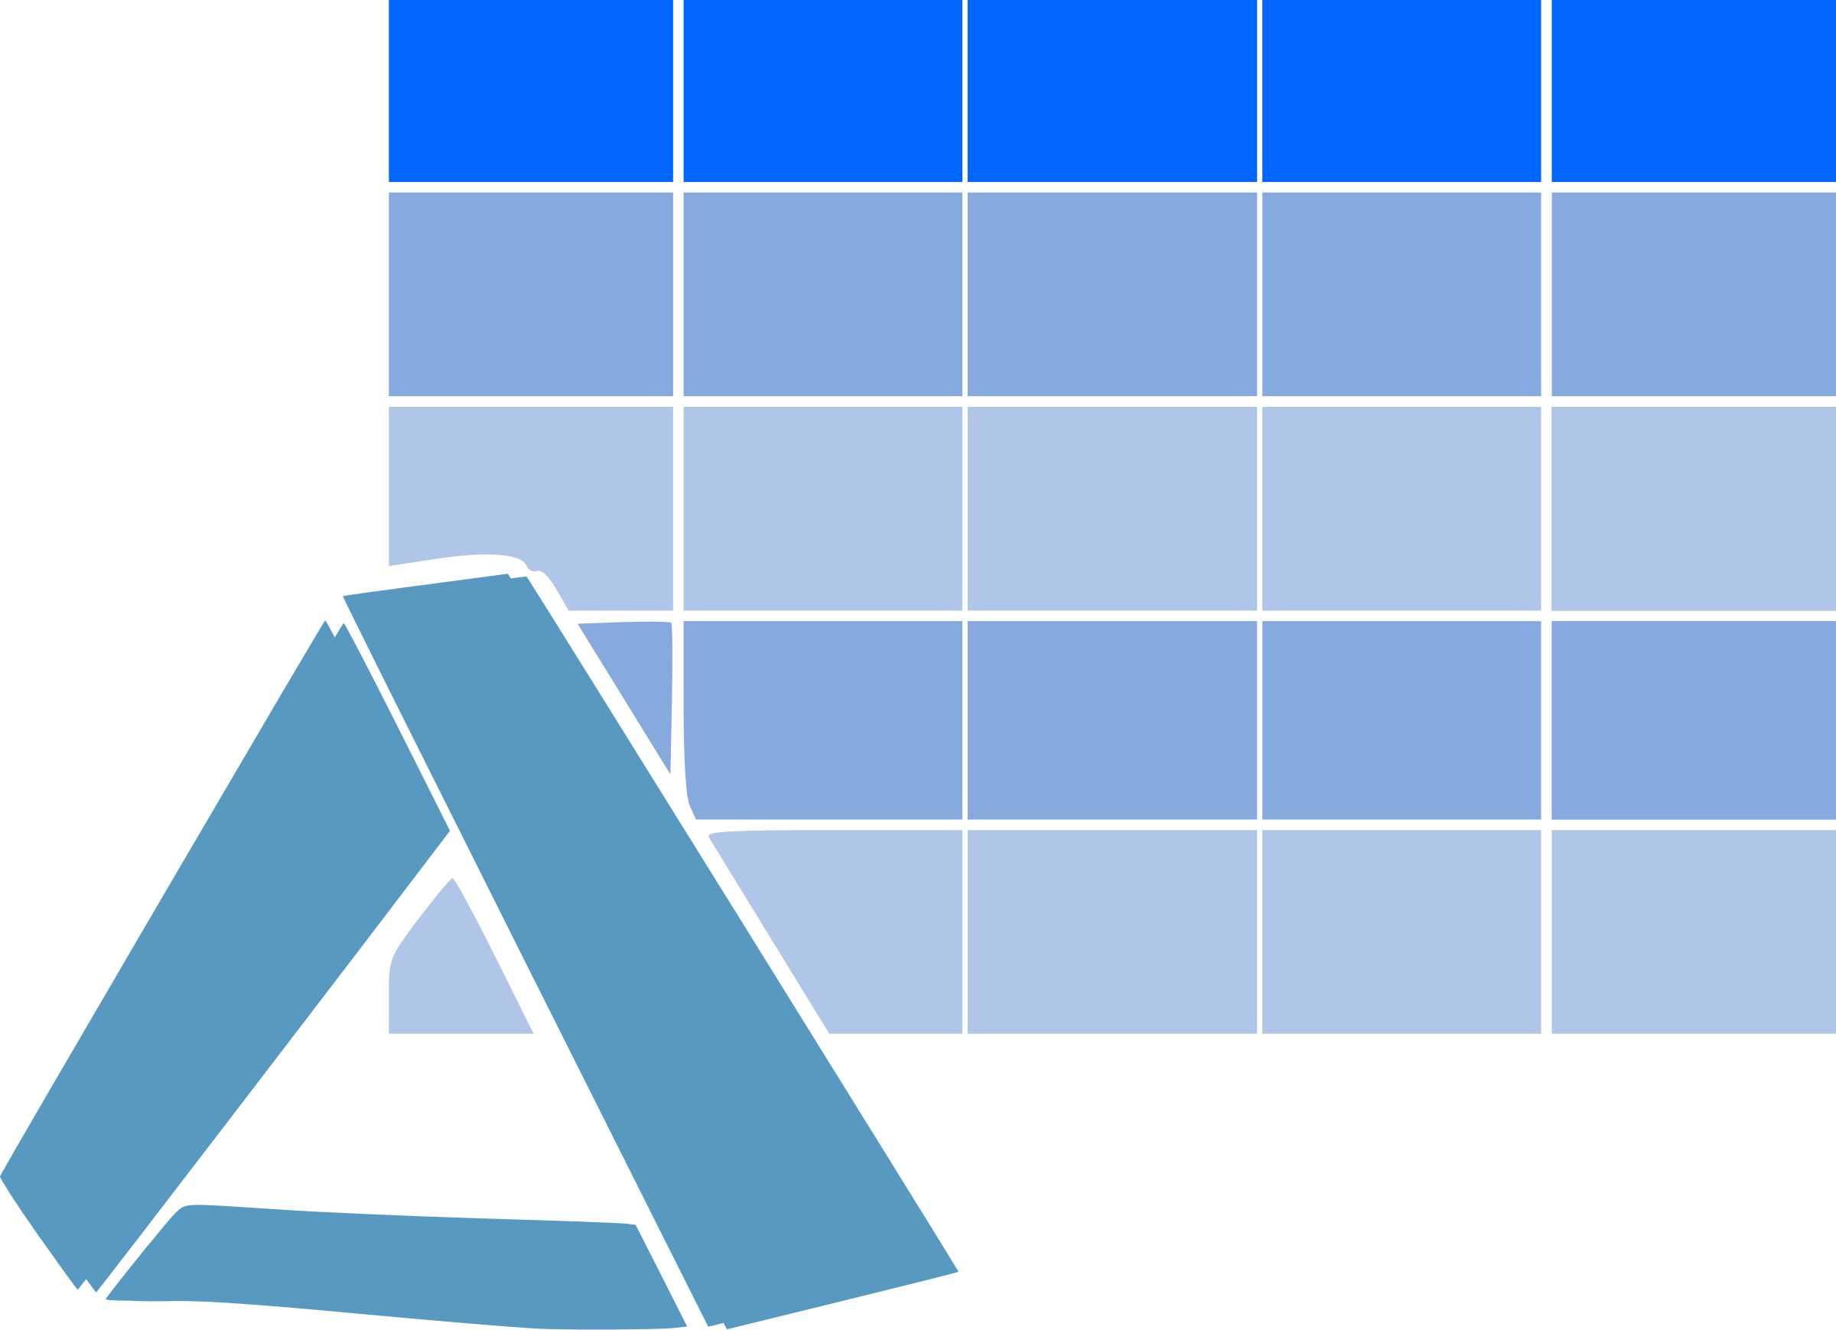
The landscape of a Microsoft Fabric solution! (My thinking)
The Lakehouse – Medallion architecture
We can create a Lakehouse leveraging the Medallion Architecture
Placing each metal in a dedicated workspace
Bronze (Landing Zone)
Silver
Gold (Business level aggregates)
Data Integration

Slide 16
The landscape of a Microsoft Fabric solution! (My thinking)
The Lakehouse – Medallion architecture
We can create a Lakehouse leveraging the Medallion Architecture
Placing each metal in a dedicated workspace
Bronze (Landing Zone)
Silver
Gold (Business level aggregates)
Data Integration
Different stages of the Medallion architecture may be placed on different capacities

Slide 17
The landscape of a Microsoft Fabric solution! (My thinking)
The Lakehouse – Medallion architecture
Using dedicated compute power (a capacity) for Data Science workloads because these workloads might run less or more frequently, require extra computing power, or …
Bronze (Landing Zone)
Silver
Gold (Business level aggregates)
Data
Science

Slide 18
The landscape of a Microsoft Fabric solution! (My thinking)
Using dedicated compute power (a capacity) for Data Science workloads because these workloads might run less frequently, require extra computing power, or are shared between multiple Fabric solutions. Be aware of data residency requirements!

Slide 19
The landscape of a Microsoft Fabric solution! (My thinking)
Multiple Power BI solutions with a semantic model in Direct Lake connection mode are reading delta tables from the Gold layer.
All semantic models might share the same capacity

Slide 20
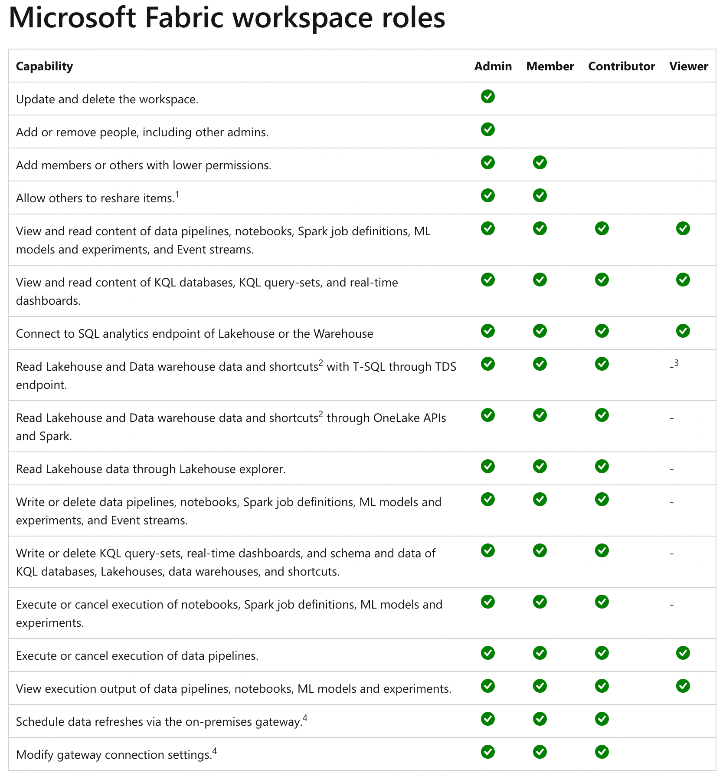
The “simple” Power BI workspace roles are not simple anymore
https://learn.microsoft.com/en-us/fabric/get-started/roles-workspaces

Slide 21

And now, what?
Get ready for new capabilities!
Understanding core concepts of Microsoft Fabric like
OneLake, Shortcuts and the separation of storage and compute is a must!
We must think about how to organize the awesomeness!

Slide 22
Thank you

